Slide 1
SECURE DATA HIDING IN IMAGES USING STEGANOGRAPHY
CAPSTONE PROJECT
Presented By:MD.MASEERA KOWSER
Student Name : MD.MASEERA KOWSER
College Name & Department : PBR VITS &CSE

Slide 2
OUTLINE
Problem Statement
Technology used
Wow factor
End users
Result
Conclusion
Git-hub Link
Future scope

Slide 3
Problem Statement
The increased reliance on digital communication has amplified the need for secure data transmission. Traditional encryption methods are widely used but often raise suspicion or draw attention. Steganography offers a solution by embedding sensitive data into media files (e.g., images) without altering their apparent content. This project uses Python and OpenCV to hide and extract messages from images, ensuring that only authorized users can decrypt the hidden information with a password.

Slide 4
Technology used
1. Programming Language: Python 3.x – Chosen for its simplicity, cross-platform support, and vast ecosystem of libraries.
2. Libraries:
- OpenCV (cv2): A powerful library for image processing, used to read, manipulate, and save images.
- OS Module: Facilitates file operations like opening, saving, and managing encrypted image files.
- String Module: Provides predefined character sets for converting characters to ASCII values.
3. Development Environment:
- IDEs: Jupyter Notebook, PyCharm, or VS Code – Used for code development, testing, and debugging.
- Cross-Platform Support: The project is designed to run on Windows, Linux, and macOS systems without any modification

Slide 5
Wow factors
1. Invisible Data Embedding: The image is subtly altered without any noticeable changes to its appearance, making detection difficult.
2. Password-Protected Decryption: Only users with the correct password can decrypt the hidden message, ensuring robust security.
3. Efficient Pixel Manipulation: Embeds ASCII values into different RGB channels for efficient and secure storage.
4. Customizable Message Length: The system can handle variable message lengths depending on the image size and resolution.
5. Low Detection Risk: The human eye cannot easily distinguish between an original image and a modified one.
6. Data Integrity Assurance:Ensures that the decrypted message is accurate and unchanged.
7. Educational Demonstration of Steganography: Introduces the basic principles of embedding messages within images, a key concept in cybersecurity.

Slide 6
End users
This project can be applied by a wide range of users:
1. Government and Intelligence Agencies: For secure covert communication.
2. Journalists and Whistleblowers: To protect the anonymity of sensitive sources and data.
3. Military and Defense Organizations: To transmit sensitive data securely.
4. Corporate Sector:Protects confidential business information during digital transfers.
5. Cybersecurity Professionals:Demonstrates how data can be securely embedded in images.
6. Forensic Investigators & Law Enforcement: Helps in embedding case-sensitive information for investigative purposes.
7. General Public & Privacy Enthusiasts:Allows individuals to keep personal communications private and undetectable.

Slide 7
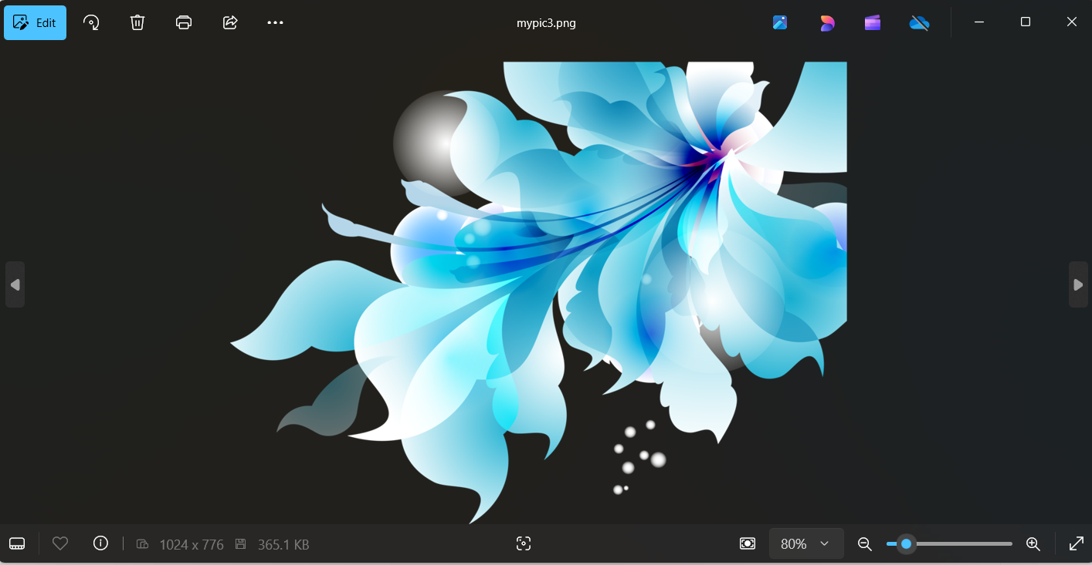
Results

Slide 8
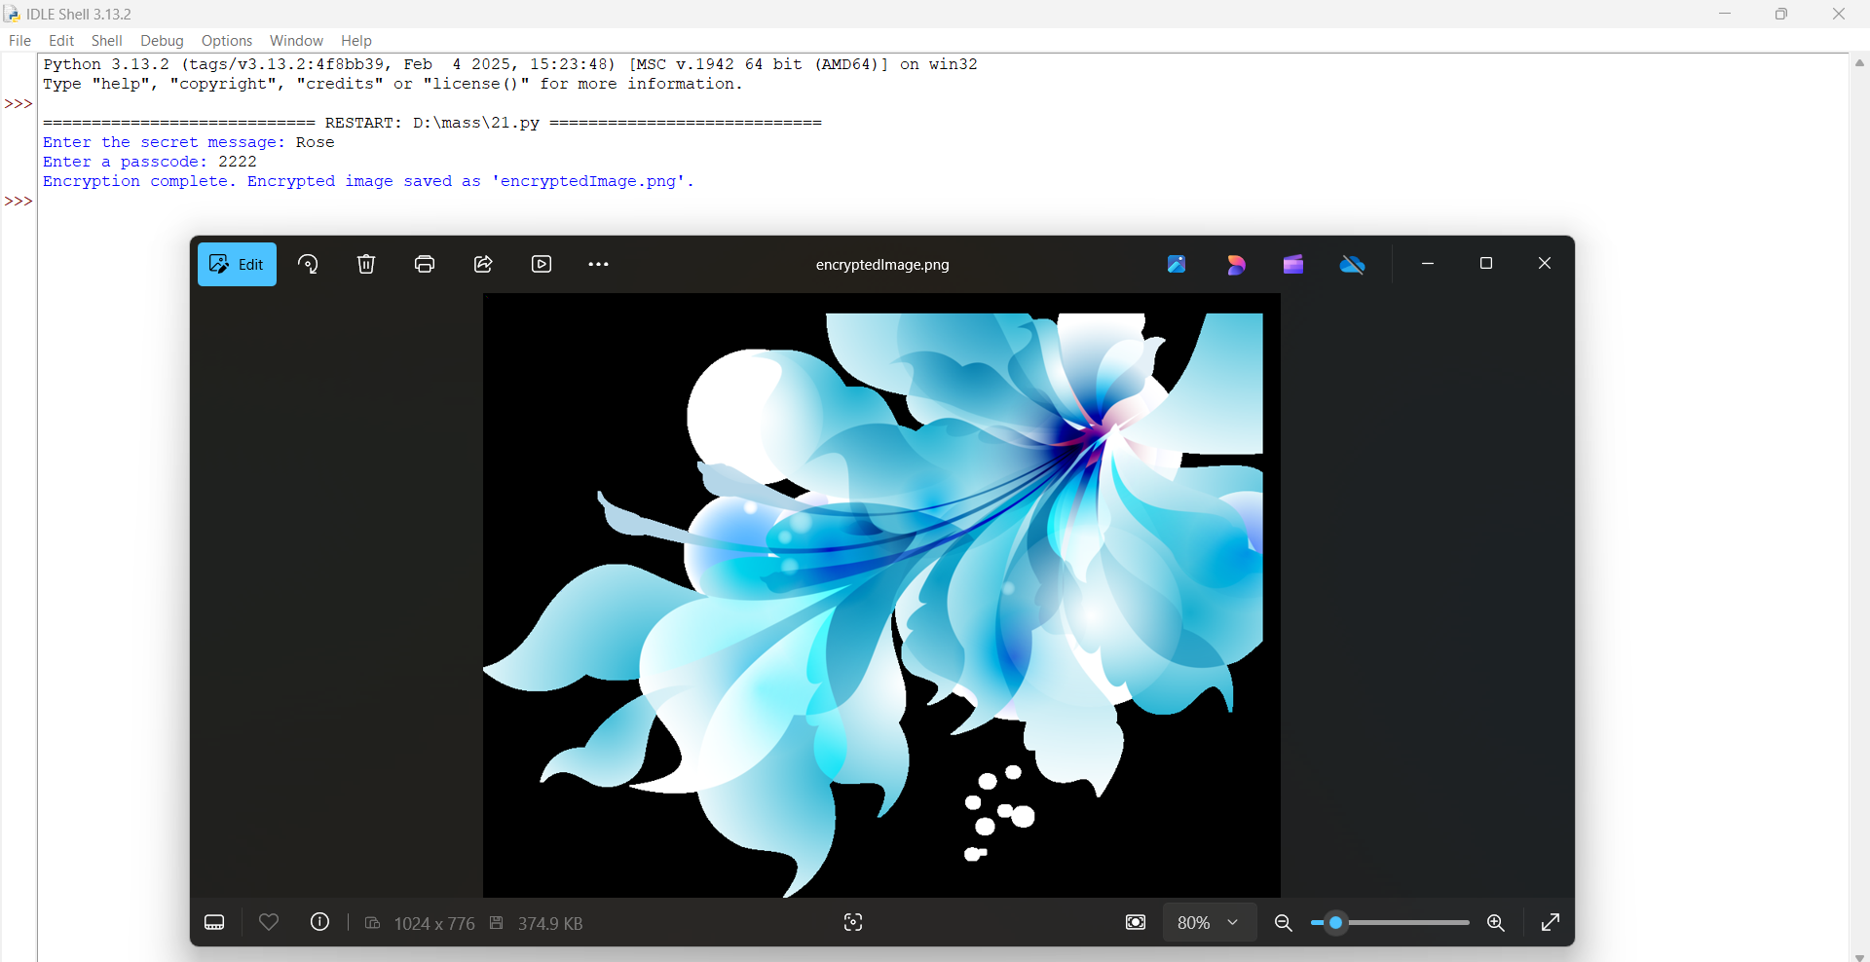
results

Slide 9
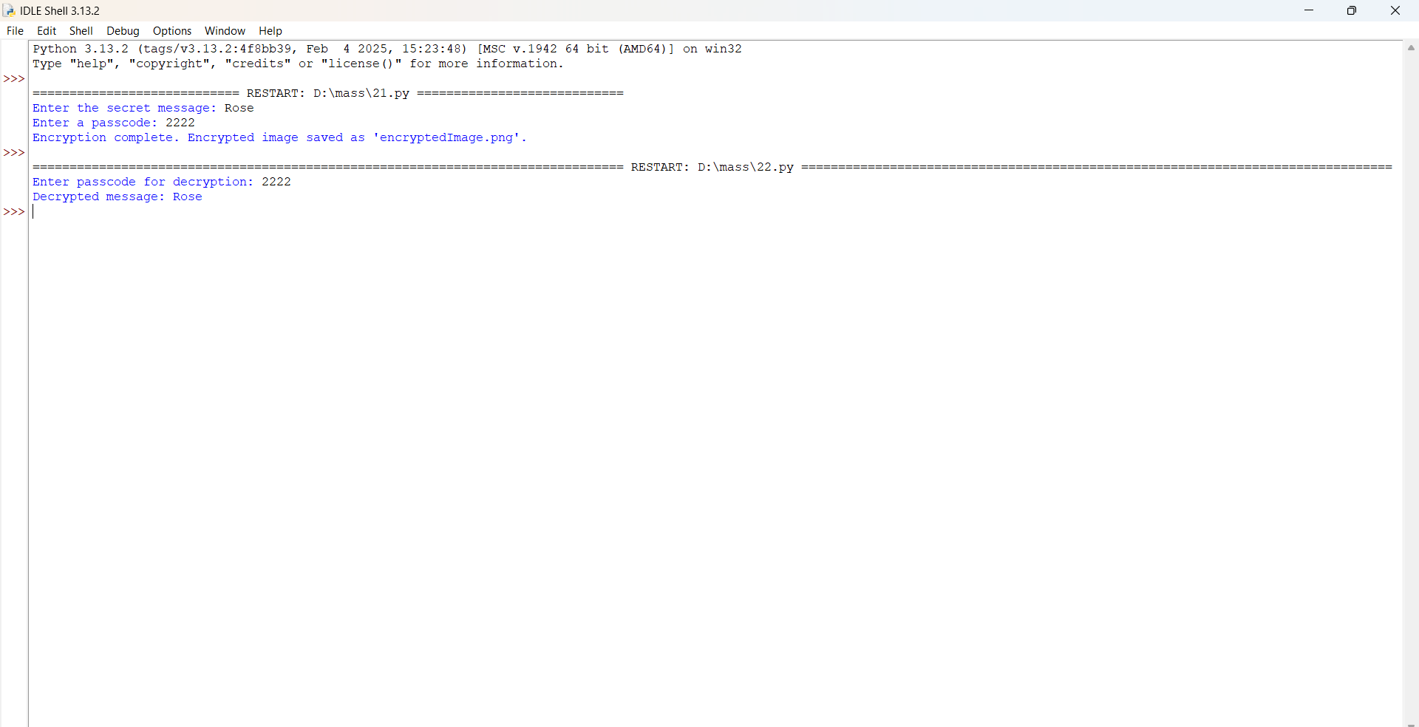
results

Slide 10
Conclusion
This project showcases the successful embedding of secret messages into images using pixel manipulation and password protection. By leveraging Python and OpenCV, the project highlights the potential of image-based encryption as a secure and covert communication tool. It lays the groundwork for more sophisticated steganographic systems with enhanced security features.

Slide 11
GitHub Link
GitHub Repository: https://github.com/Maseera2004/Steganography.git

Slide 12
Future scope
1. User-Friendly Interface: Develop a graphical user interface (GUI) to allow users to easily upload images and input messages for encryption and decryption.
2. Advanced Steganography Techniques: Explore more complex techniques to further obscure hidden messages within images.
3. Real-Time Encryption: Implement support for encrypting video streams and live feeds, enabling dynamic data hiding in real-time.
4. Enhanced Security:Introduce multi-pass encryption, checksum validation, and multi-factor authentication for added layers of protection.
5. Cloud Integration: Enable cloud-based steganography to facilitate secure data transmission over the internet.

Slide 13
THANK YOU

